Slide 1


HỌC VIỆN CÔNG NGHỆ BƯU CHÍNH VIỄN THÔNG
COMPUTER ARCHITECTURE
INTEL 8086/8088
Instructor: Associate Professor Phạm Văn Cường
E-mail: cuongpham.ptit@gmail.com
www: https://sites.google.com/view/cuongpham/home

Slide 2
CONTENT
  Functional Diagram
  Components
  3. Instruction coding
  4. 8086/8088 addressing modes
  5. Instruction set
  6. Pipeline

Slide 3
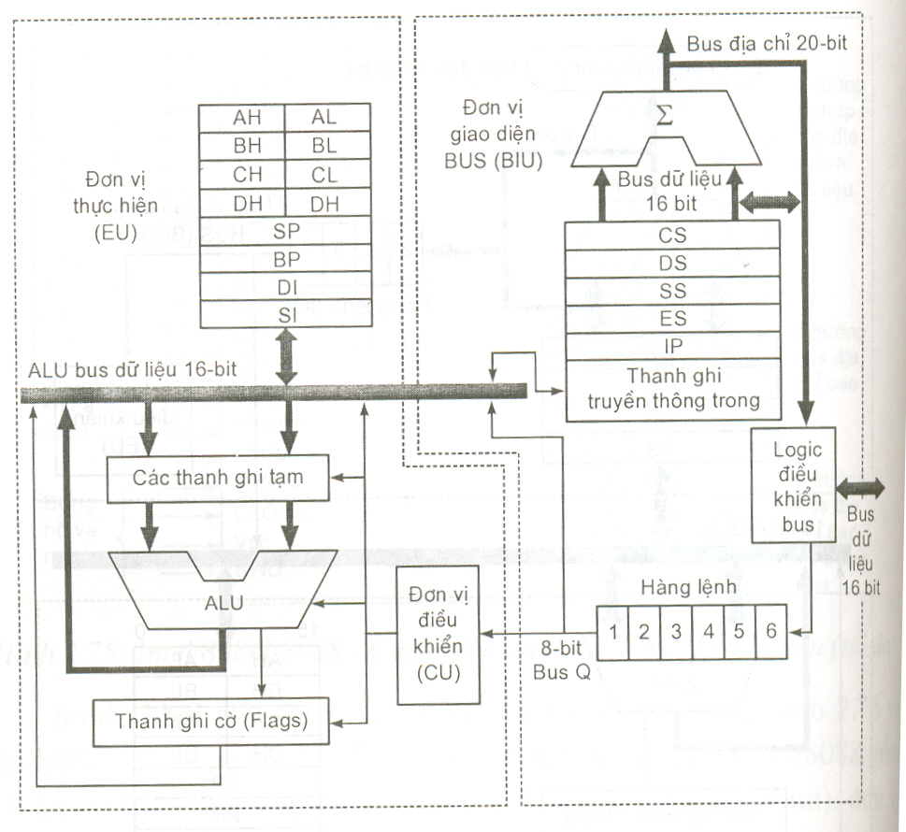
8086/8088 diagram

Slide 4
8088/8086 units
Bus Interface Unit
  Controlize system bus:
    Look up address
    Fetch op-code from memory
    read/write data from/to memory or I/O
  including:
    Adder
    CS, DS, SS, ES
    PC/IP
    Instruction Queue
    Bus controller

Slide 5
8088/8086 units
Execution Unit
  EU receives op-code & data from BIU. Results are transferred to memory or I/O.
  units:
    ALU
    CU
    AX, BX, CX, DX, SP, BP, SI, DI

Slide 6
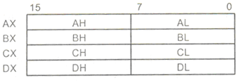
8086/8088 registers
General-purposed registers:
  16 bits:
    AX: Accumulator (input operant and output)
    BX: Base (address)
    CX: Count (counting the loop)
    DX: Data
  Can be splited into 8 bit registers: AH AL, BH, BL, CH, CL, DH, DL

Slide 7
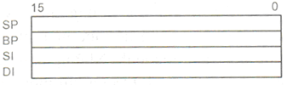
8086/8088 registers
Pointer and indexing (16 bits):
  SP (Stack Pointer): points to the top of stack
  BP (Base Pointer): used with stack segments
  SI (Source Index): for data movement
  DI (Destination Index): for data movement

Slide 8
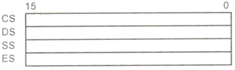
8086/8088 registers
  CS (Code Segment): points to the segment containing the code
  DS (Data Segment): points to the segment containing the data
  SS (Stack Segment): points to the segment containing the stack
  ES (Extra Segment): points to the segment containing the extra data.

Slide 9

8086/8088 registers
Instruction pointer & Flag register:
  IP (Instruction Pointer): so-called PC(Program Counter) containing the address of the next instruction to be executed;
  FR (Flag Register).

Slide 10
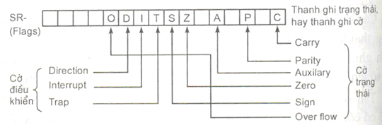
8086/8088 Flag register

Slide 11
8086/8088 registers
Status flags:
  CF (Carry Flag): C=1→ if carry; C=0→otherwise
  AF (Auxiliary Flag): AF=1→ if carry between 3rd and 4th bit; AF=0→otherwise
  PF (Parity Flag): PF=1 if sum of bit 1s is odd; PF=0 if sum of bit 1s is even
  OF (Overflow Flag): OF=1 if overflowed in results
  ZF (Zero Flag): ZF=1 if the result equals to 0; ZF=0 otherwise
  SF (Sign Flag): SF=1 if the result is negative; SF=0 otherwise
Control flags:
  DF (Direction flag)
  TF (Trap/Trace flag)
  IF (Interrupt flag)
Notes:
17.8 D08.3

Slide 12
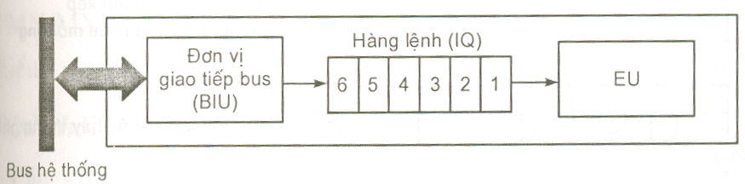
Instruction Queue
  Containing op-code.
  Speed-up.
Notes:
D08.2 17.8

Slide 13
Instruction set
What is an instruction?
  A binary word
  Stored in memory
  Fetched by CPU to be executed
  Each has it own operation
Execution stages:
  IF: Instruction Fetch
  ID: Instruction Decode
  EX: Instruction Execution
  MEM: Memory Access
  WB: Write Back

Slide 14
Instruction
  Two components: op-code and operants
  length: 8, 16, 24, 32 and 64 bits.
  8086/8088 instructions have lengths from 1 to 6 bytes
Opcode
Operands
Mã lệnh
Đích, Gốc
MOV
AX, 100
AX ← 100

Slide 15
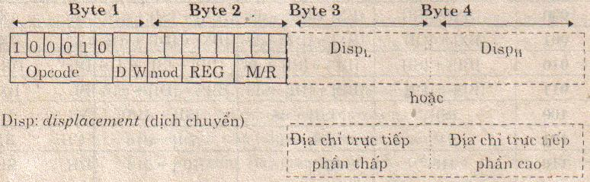
Instruction coding
  Opcode: of MOV is 6 bít; 100010
  D: data direction; D=1: data to REG; D=0: data from REG;
  W:operant length; W=0: 1 byte; W=1: 2 bytes

Slide 16
Instruction coding
  REG: 3 bits operant register:
    D=1, REG is the destination operant
    D=0, REG is the source operant
registers |  | code
W=1 | W=0
AX | AL | 000
BX | BL | 011
CX | CL | 001
DX | DL | 010
SP | AH | 100
DI | BH | 111
BP | CH | 101
SI | DH | 110
Segment registers | code
CS | 01
DS | 11
ES | 00
SS | 10

Slide 17
8086/8088 addressing mode
Addressing Mode: CPU organises and looks up data for operants while the instruction being executed;
8086/8088 has 7 addressing modes:
  Register Addressing Mode
  Immediate Addressing Mode
  Direct Addressing Mode
  Register Indirect Addressing Mode
  Based Plus Displacement Addressing Mode
  Indexed Plus Displacement Addressing Mode
  Based Indexed Plus Displacement Addressing Mode

Slide 18
8086/8088 addressing mode
Register addressing mode:
  Using CPU registers as operants.
  Both source and destination operants are registers
  Example:
      mov bx, dx; bx ← dx
      mov ds, ax; ds ← ax
      add al, dl; al ← al + dl

Slide 19
8086/8088 addressing mode
Intermediate addressing:
  Destination operant is a register or a memory cell
  Source operant is a constant
  Example:
      mov cl, 200; cl ← 200
      mov ax, 0ff0h; ax ← 0ff0h
      mov [bx], 200; stores 200 into the memory cell whose address is in DS:BX

Slide 20
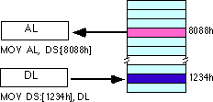
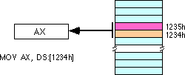
8086/8088 addressing mode
Direct addressing:
  One operant is a constant indicating an address of a memory cell
  The other operant can be a register
  Example:
    MOV AL, [8088H]
    MOV [1234H], DL
    MOV AX, [1234H]

Slide 21
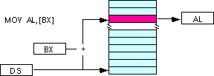
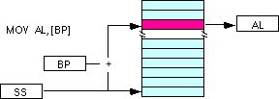
8086/8088 addressing mode
Indirect addressing:
  One operant is a register containing an address of a memory cell
  The other can be a register
  Example:
    MOV AL, [BX]; AL ← [DS:BX]
    MOV AL, [BP]; AL ← [SS:BP]

Slide 22
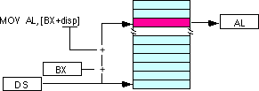
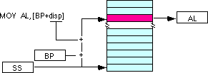
8086/8088 addressing mode
Based-relative addressing:
  One operant is an address of a memmory cell (base and displacement).
  The other can be a register
  Example:
MOV AL, [BX+100]; AL ← [DS: BX+100]
MOV AL, [BP+200]; AL ← [SS: BP+200]

Slide 23
8086/8088 addressing mode
Indexed relative addressing
  Similar to based relative addressing mode, but base pointer is replaced with indexing register (SI,DI)
  Example:
    MOV AL, [SI+100]; AL ← [DS: SI+100]
    MOV AL, [DI+200]; AL ← [DS: DI+200]

Slide 24
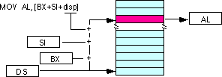
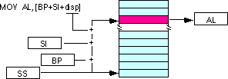
8086/8088 addressing mode
Based, indexed relative addressing
  Combined based relative and indexed relative addressing modes
Example:
MOV AL, [BX+SI+100]; AL←[DS:BX+SI+100]
MOV AL, [BP+DI+200]; AL←[SS:BP+DI+200]

Slide 25
Instruction set
  Data movement
  Computation
  Bit operation and logics
  Condition and loop
  others

Slide 26
Data movement
between:
  register–register;
  register–memory;
  register–I/O.
Example:
  MOV
  LODSB, LODSW, STOSB, STOSW
  MOVSB, MOVSW
  IN, OUT

Slide 27
Data movement
MOV:
  MOV dst, src; dst← src
  Moving data from src to dst
  Note: dst and src have the same size
  Example: MOV AL, 100; AL ← 100
  MOV [BX], AH; [DS:BX] ← AH
  MOV DS, AX; DS ← AX

Slide 28
Data movement
IN:
  IN reg, <the address of input port>
  Read an data item from the input port and assign to reg
  Example: IN AL, 0F8H; AL ← (0F8h)
  MOV DX, 02F8H
  IN AL, DX; AL ← (DX)

Slide 29
Data movement
OUT:
  OUT <the address of output port>, reg
  Write an data item from reg to the output port.
  Example: OUT 0F8H, AL; (0F8h) ← AL
  MOV DX, 02F8H
  OUT DX, AL; (DX) ← AL

Slide 30
Numerical computation
ADD:
  ADD <dst>, <src>; dst← dst +src
  Example ADD AX, BX; AX ← AX + BX
  ADD AL, 10; AL ← AL + 10
  ADD [BX], AL; [DS:BX] ← [DS:BX] + AL

Slide 31
Numerical computation
SUB :
  SUB <dst>, <src>; dst ← dst -src
  Example: SUB AX, BX; AX ← AX - BX
  SUB AL, 10; AL ← AL - 10
  SUB [BX], AL; [DS:BX] ← [DS:BX] - AL

Slide 32
Numerical computation
MUL
  MUL <src>;
  Scr must be an variable
  description:
    If src is 8 bit: AX ← AL *src
    If src is 16 bit: DXAX ← AX * src
  Example: 10 * 30
  MOV AL, 10; AL ← 10
  MOV BL, 30; BL ← 30
  MUL BL; AX ← AL * BL
Notes:
D08.2 1.9

Slide 33
Numerical computation
DIV
  DIV <scr>
  Scr must be a variable
  description:
    If scr is 8 bit: AX : scr; AL= thuong so; AH= remaining
    If scr is 16 bit: DXAX :scr; AX = DX= remaining
  Example: 100 : 30
  MOV AX, 100; AL ← 100
  MOV BL, 30; BL ← 30
  DIV BL; AX : BL; AL = 3, AH = 10
Notes:
D08.3 31.8

Slide 34
Logical computation
NOT, AND, OR, and XOR
X | Y | NOT | AND | OR | XOR
0 | 0 | 1 | 0 | 0 | 0
0 | 1 | 1 | 0 | 1 | 1
1 | 0 | 0 | 0 | 1 | 1
1 | 1 | 0 | 1 | 1 | 0

Slide 35
Bit computation
  SHL (Shift Left)
  SHR (Shift Right)
  ROL (Rotate Left)
  ROR (Rotate Right)

Slide 36
Bit computation
SHL
  SHL <dst>, 1
  SHL <dst>, CL
    MSB (Most Significant Bit) written to CF
    0 is filled in LSB (Least Significant Bit)
    All bits between MSB and LSB are left shifted 1 bit;
    Example :
      MOV AL, 08H; 0000 1000B (8)
      SHL AL, 1; 0001 0000B (16)
      MOV CL, 2
      SHL AL, CL; 0100 0000B (64)
CF
MSB
LSB
0

Slide 37
Bit computation
SHR
  SHR <dst>, 1
  SHR <dst>, CL
    CF=LSB (Least Significant Bit)
    MSB (Most Significant Bit)=0
    Bits between MSB and LSB are right shifted by 1 bit
  Example:
      MOV AL, 80H; 1000 0000B (128)
      SHR AL, 1; 0100 0000B (64)
      MOV CL, 2
      SHR AL, CL; 0001 0000B (16)
0
MSB
LSB
CF

Slide 38
Bit computation
ROL
  ROL <dst>, 1
  ROL <dst>, CL
    CF=MSB (Most Significant Bit)
    LSB (Least Significant Bit)= MSB
    Bits between MSB and LSB are left shifted by 1 bit
  Example:
      MOV AL, 88H; 1000 1000B
      ROL AL, 1; 0001 0001B
      MOV CL, 2
      ROL AL, CL; 0100 0100B
CF
MSB
LSB

Slide 39
Bit computation
ROR
  ROR <dst>, 1
  ROR <dst>, CL
    CF=LSB (Least Significant Bit)
    MSB (Most Significant Bit)=LSB
    Bits betweeb MSB and LSB are right shifted by 1 bit
  Eg.:
      MOV AL, 88H; 1000 1000B
      ROR AL, 1; 0100 0100B
      MOV CL, 2
      ROR AL, CL; 0001 0001B
MSB
LSB
CF

Slide 40
Flow control instructions
program flow control instructions can change the order of instruction execution;
Eg.:
  Unconditional jump: JMP
  Conditional jump: JE, JZ, JNE, JNZ, JL, JLE, JG, JGE, ...
  Loop: LOOP, LOOPE, LOOPZ
  CALL
  RET

Slide 41
Flow control instructions
JMP
  JMP <label>
  Eg.:
      START:
      ADD AX, BX
      SUB BX, 1
      ......
      JMP START ; jump to START

Slide 42
Flow control instructions
Conditional jump: JE, JZ, JNE, JNZ, JL, JG
  JE <label> : jump if equal
  JZ < label > : jump if zero
  JNE < label > : jump if not equal
  JNZ < label > : jump if not zero
  JL < label > : jump if less than
  JLE < label > : jump if less than or equal
  JG < label > : jump if greater than
  JGE < label > : jump if greater than or equal

Slide 43
Flow control instructions
  Example: sum from 1 to 20
      MOV AX, 0 ; AX is sum
      MOV BX, 20 ; BX for counting
      START:
      ADD AX, BX ; adding
      SUB BX, 1 ; BX=BX-1
      JZ STOP ; jump to STOP if BX = 0
      JMP START ; jump to START
      STOP: ....

Slide 44
Flow control instructions
LOOP
  LOOP <label>
  Instruction block iterately executes if CX <>0. CX automatically decreases by 1 after one loop executing one time.
  Eg.: sum from 1 to 20
      MOV AX, 0 ; AX=sum
      MOV CX, 20 ; CX=number of loops
      START:
      ADD AX, CX ; adding
      LOOP START ; if CX=0 →stop
      ; otherwise CX ← CX-1 and jump to START

Slide 45
Flow control instructions
INT,CALL and RET
INT <interrupt number>
    CALL <sub-prog>; call a sub-program
    RET ; return from a sub-program
  Example:
      CALL GIAITHUA ; call the sub-program GIAITHUA
      .....
      ; code of sub-program
      GIAITHUA PROC;
      code of sub-program
      RET ;
      GIAITHUA ENDP ; ends

Slide 46
Other instructions
  NOP (No Operation):
    NOP doesn’t change state of the machine; taking an instruction cycle time
  HLT (Halt)
    HLT stops a running program

Slide 47
Other instructions
INC
  INC <dst> ; dst← dst+ 1
DEC
  DEC <dst> ; dst← dst– 1
CMP
  CMP <dst>, <src>

